Slide 1
Magnetic Properties of Matter

Slide 2
So far on the topic of "Magnetic field"
Permanent magnet
The south and north pole of a magnet cannot be separated
Magnetisation of objects
When current flows through a conductor, a magnetic field is created
The magnetic field acts on a moving charge
Where does the magnetic field come from??

Slide 3
...
Until when?

Slide 4

What is a current?
Conductor
$$I=\frac{Q}{t}$$
Current (over time t)
Electrons with charge Q
Notes:
Slide 5: Планетарен модел на атомот - Planetary model of the atom
Протон- proton
Електрон- electron
Орбитално магнетно поле - orbital magnetic moment
Slide 6: Планетарен модел на атомот - Planetary model of the atom
Спинско магнетно поле - spin magnetic moment
Секое магнетно поле е создадено од полнеж во движење - Every magnetic field is created by a charge in motion!
На неколку места: Назад- Back

Slide 5
Planetary model of the atom​
orbital magnetic moment​
$$\vec{B}$$
electron
proton

Slide 6
Planetary model of the atom​​
Spin magnetic moment
Every magnetic field is created by a charge in motion!​
$$\vec{B}$$
Spin

Slide 7
Then why don't all materials have the same magnetic properties?
Two electrons with opposite spin
All materials do not have the same atoms
Some materials do have a net spin magnetic moment
No net spin magnetic moment

Slide 8
Classification of materials
ferromagnetics
paramagnetics
diamagnetics
iron( Fe)
cobalt(Co)
nickel( Ni)
bismuth(Bi)
gadolinium(Gd)
aluminium(Al)
platinum(Pt)
oxygen(O)

Slide 9
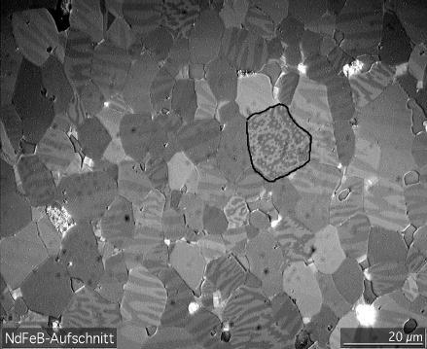
Ferromagnetics
Dominated by spin magnetic momentum
Strong atom-atom interactions
Zones are created, which are called magnetic domains
MICROSCOPIC (can be seen with a microscope)

Slide 10
In an external magnetic field
Ferromagnetic
Domain

Slide 11
$$\vec{B}$$

Slide 12
$$\vec{B}$$
Back

Slide 13
Paramagnetics
Dominated by orbital magnetic moment
Weak atom-atom interactions
No formation of domains

Slide 14
In an external magnetic fiels
Paramagnetic

Slide 15
$$\vec{B}$$
Back

Slide 16
Diamagnetics
When not in a magnetic field, they do not show any magnetic properties
What happens when the material is in a magnetic field?

Slide 17
In an external magnetic field
Diamagnetic

Slide 18
$$\vec{B}$$
Back

Slide 19
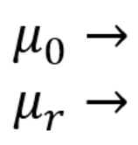

Relative permeability
permeability of free space
relative permeability
Magnetic induction in the material
$$μ_{r}=\frac{B}{B_{0}}$$
Magnetic induction in free space

